Slide 1
Chapter10 - Gravitation
Discovery of gravity
Newton’s law of gravitation

Slide 2
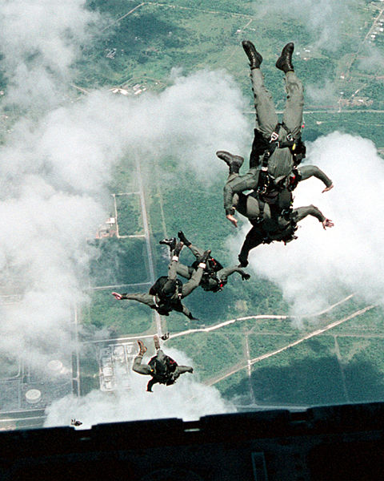
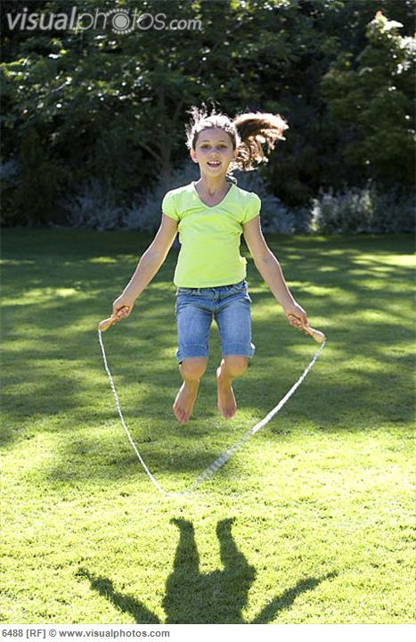
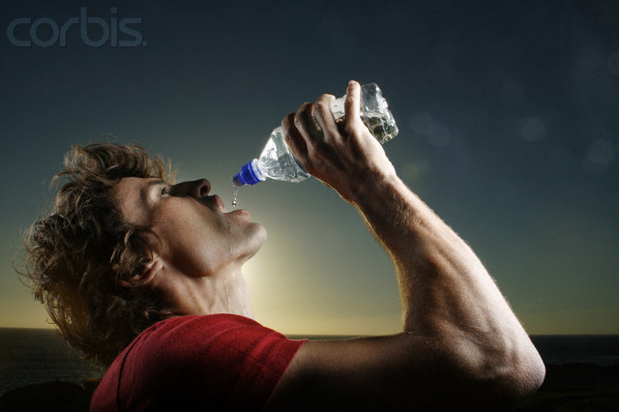
GRAVITATION
Why are they racing towards the earth…?
Even a simple task like drinking water would become difficult without gravity.
Can you imagine skipping without gravity
Its Gravity..!!!

Slide 3

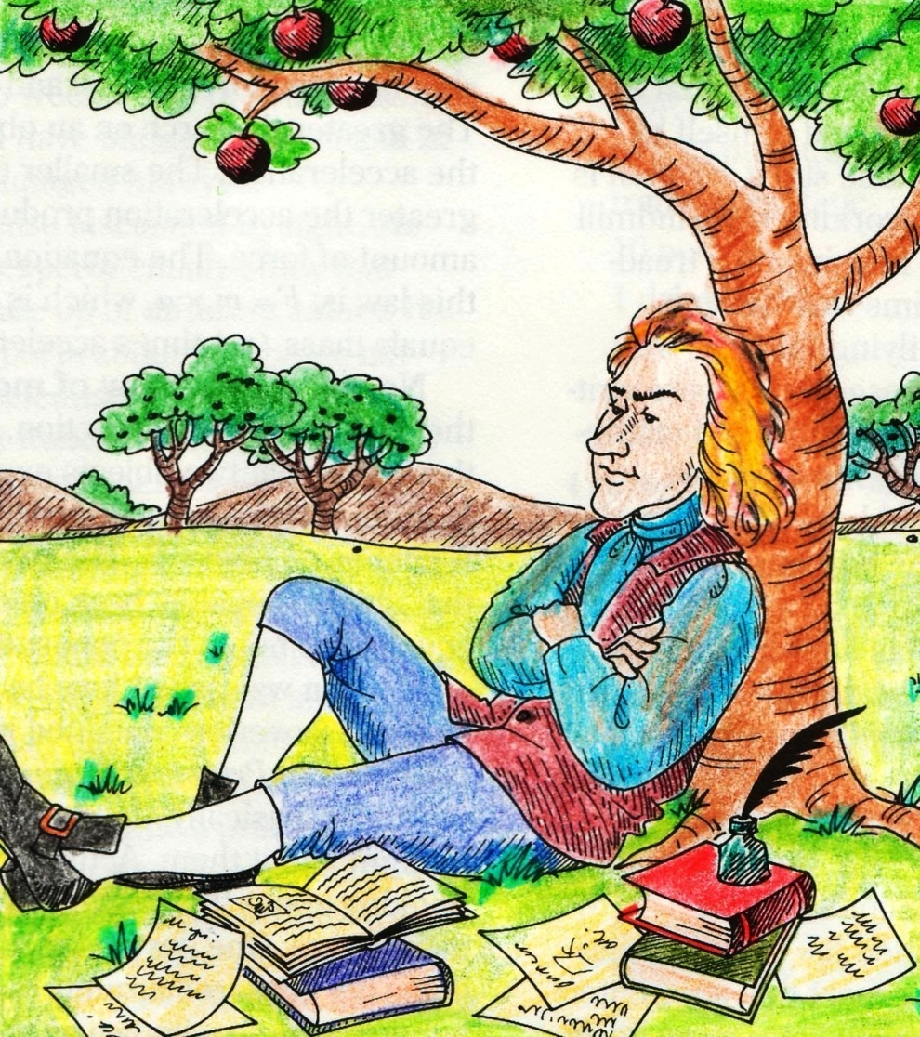
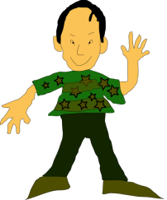


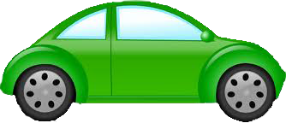
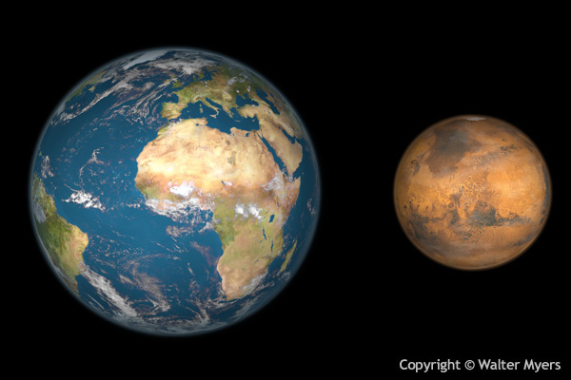



Newton thought further, gravitational force is not just between the Earth and an apple.
How was gravity discovered…?
Newton was relaxing under a apple tree
Attraction
A
An apple fell on newton
B
GRAVITATIONAL FORCE ACTS
BETWEEN ANY TWO BODIES
Now this is absured
Gravity was discovered
Attraction
Newton started to analyse
So if there are two bodies. A and B, there is a force of attraction between them.
F
But we don’t see this happening
Lets see why..???
Attraction
If a man is walking on road and a car is passing by
Man should get attracted to the car
Planets around earth should get attracted to each other

Slide 4

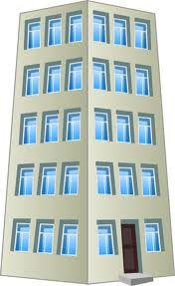
Newton’s Law of Gravitation
Every object in the universe attracts every other object with a force,
which is directly proportional to the product of their masses
and inversely proportional to the square of distance between their centers .
directly proportional
inversely proportional
Of one physical quantity increases other physical quantity also increases
m₁
m₂
If one physical quantity increases other physical quantity decreases.
F
F
F α m₁m₂
Mass of earth is huge, so person gets attracted to earth
1
r
F α
m₁
……… (1)
In comparison to earth the mass of car is negligible, so force of attraction is also negligible.
Let F be the force acting between two bodies
r²
Hence we do not attract object around us
If we put m₁ = m₂ = 1 and r = 1
Consider two bodies of mass m₁ and m₂
……… (2)
seperated by a distance r from the line joining the center of the mass
G 1 1
G m₁m₂
F =
F =
m₁m₂
1²
F α
….from (1) and (2)
r
r²
r²
A
B
F =
G
G m₁m₂
Universal constant of gravitation is the force of attraction between two unit masses placed at unit distance apart from each other.
F =
If distance is more force of attraction is less.
If distance is less force is more
r²
m₂
Where G is universal constant of gravitation

Slide 5
Module 02 - Gravitation
Unit of gravitation
Importance of gravitation

Slide 6
Let us Derive the unit for gravitational constant
SI unit of force is
We know that
CGS unit of force is
SI unit of displacement is
Gm₁m₂
r²
CGS unit of displacement is
F =
dyne
m²
N
cm²
Fr²
m₁m₂
G =
g²
kg²
UNITS for G
CGS unit of mass is
SI unit of mass is
SI unit of G =
C.G.S unit of G =

Slide 7
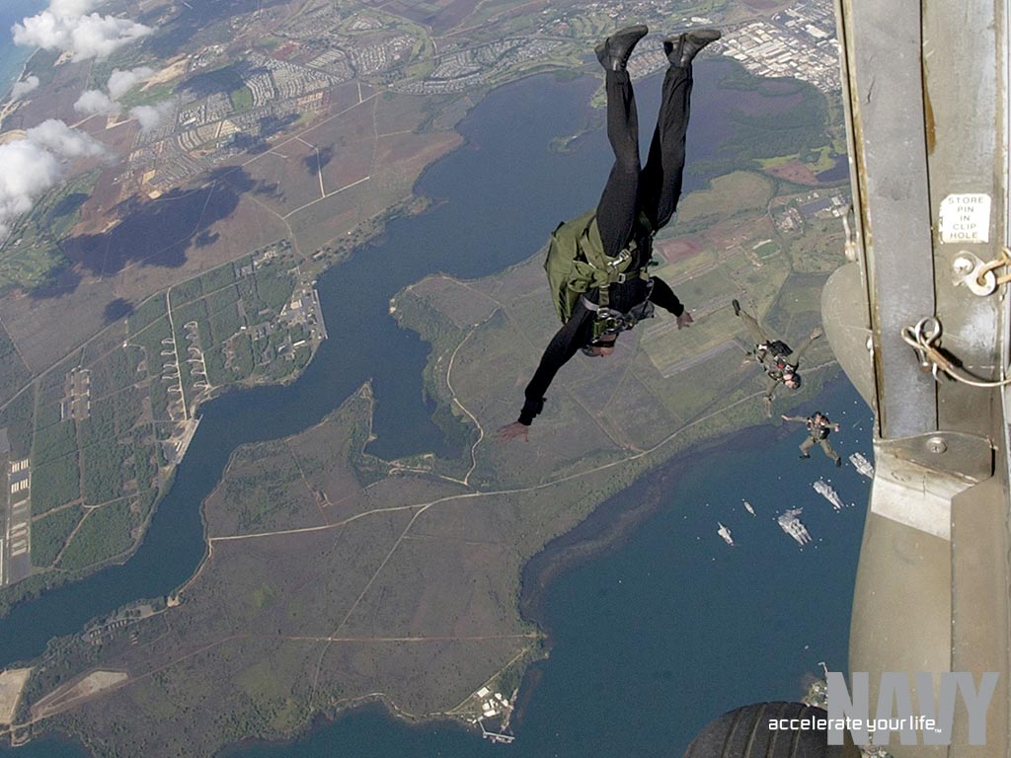
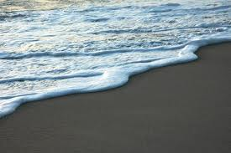
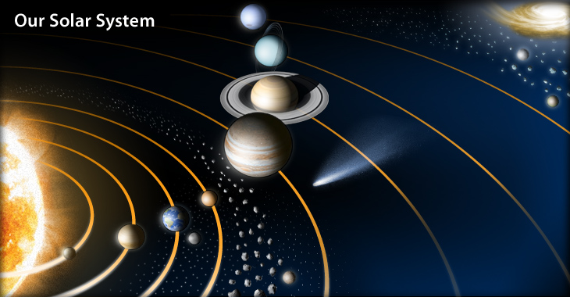
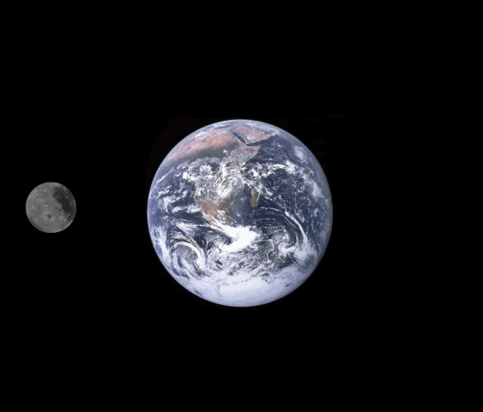
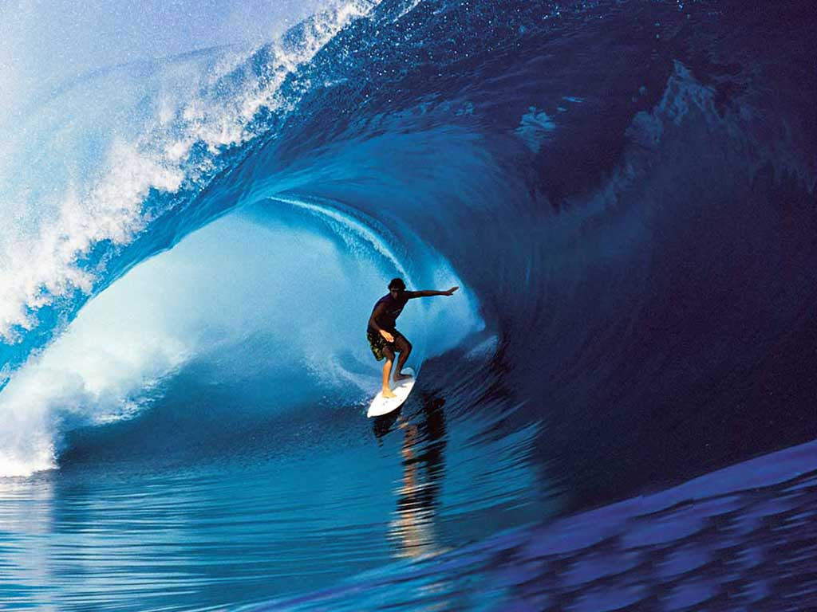
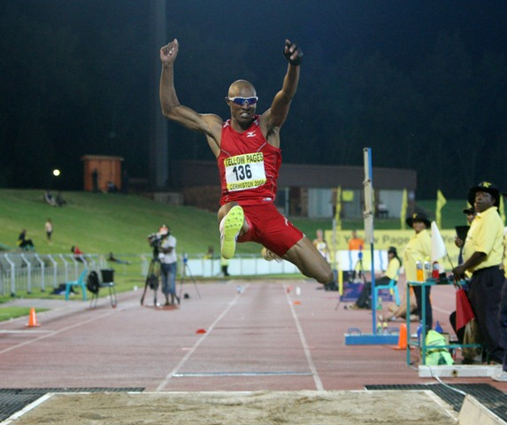
Importance of the Universal Law of Gravitation
This man is racing towards earth due to gravitational force
Moon revolves round the earth due to the gravitational attraction of earth
The planets rotate and revolve around the sun due to gravitational force
The universal law of gravitation successfully explains :
The force that binds us to the earth.
It is gravity that makes long jump so difficult
The motion of the moon around the earth.
The motion of the planets around the sun.
The tides are caused due to gravitational force of moon
The tides of the sea due to the moon and the sun.

Slide 8
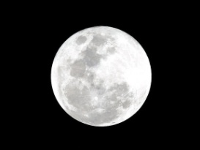
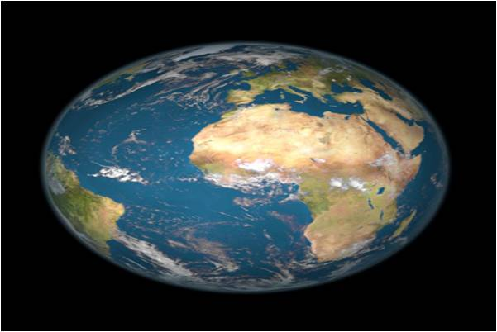
Centripetal Force
The Centripetal force is centre-seeking or the force which is acting towards the centre.
In solar system all planets are revolving around the sun due to centripetal force
In our solar system all planets revolve around the sun. There exists a force between the sun and the planets.
We know that moon is revolving round the earth in circular orbit
V
In a uniform straight line
In absence of centripetal force the moon would go tangentially
This is because of a force directed towards the center of earth
Centripetal Force

Slide 9
Module 03 - Gravitation
Relationship between S.I & C.G.S unit of gravitational constant
Acceleration due to gravity
Value of acceleration due to gravity on the surface of Earth

Slide 10

Let us find the relationship between. SI and CGS unit of gravitation constant
1m = 10²cm
∴1m² = 10⁴cm²
1Newton = 10⁵dyne
Experimentally it is observed that
1kg = 10³g
∴1kg² = 10⁶g²
dyne
x 10⁵
x 10⁴
cm²
Value of G=
6.67 x 10⁻¹¹
N m²
g²
10⁶
kg²
6.67 x 10⁻¹¹
=
66.67x10⁻¹¹x10⁹
10⁶
dyne cm²
g²
=
dyne cm²
g²
= 6.67 x 10⁻¹¹ x 10⁹ x 10⁻⁶
= 6.67 x 10⁻¹¹ x 10³
dyne cm²
g²
dyne cm²
g²
Hence
= 6.67 x 10⁻⁸
Nm²
Dyne cm²
6.67 x 10⁻¹¹ = 6.67 x 10⁻⁸
kg²
g²

Slide 11
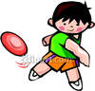
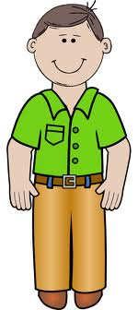
Acceleration due to gravity
(g)
Acceleration =
change in velocity
time
Newton’s Law of Gravitation
m
According to Newton’s second law
g
F = m ………… (2)
a
( acceleration due to gravity )
mg =
From (1) and (2)
R
M
g =

Slide 12
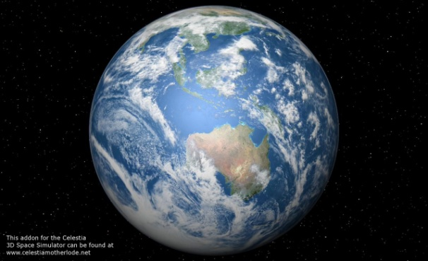
VALUE OF (g) ON THE SURFACE OF EARTH
R = 6.4 x 10⁶ m
R
M = 6 x 10²⁴ kg
GM
R²
6.67 x 6 x 10
40.96
g =
=
6.67 x 10⁻¹¹ x 6 x 10²⁴
(6.4 x 10⁶)²
400.2
10.96
=
=
6.67 x 10⁻¹¹ x 6 x 10²⁴
40.96 x 10¹²
9.8
1
=
=
6.67 x 10⁻¹¹ x 6 x 10²⁴ x 10⁻¹²
40.96
=
g = 9.8 m/s ²
6.67 x 10⁻¹¹ x 6 x 10¹²
40.96
=

Slide 13
Module 04 - Gravitation
Difference between gravitational constant and acceleration due to gravity
Difference between mass and weight
Free fall

Slide 14
Distinguish between G & g
Acceleration due to gravity of the earth
Universal gravitation constant
It the force of attraction
between two unit masses placed
at unit distance apart from each
other.
It is the acceleration caused by earth’s gravitational force on an object
Its value is taken as 6.67 × 10⁻¹¹ Nm²/kg²
Its value is taken as 9.8
m/s².
It is constant.
It is variable.

Slide 15
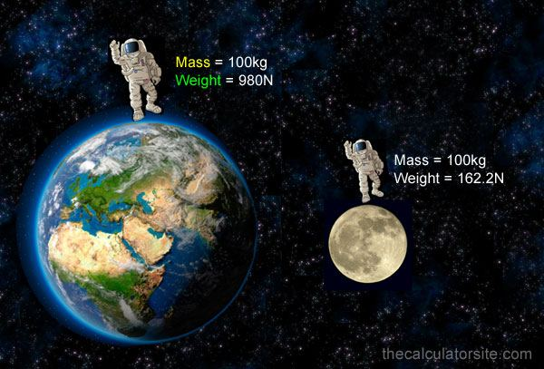
Mass and Weight

Slide 16
Mass and Weight
Mass
Weight
Mass is the quantity of
matter contained in the object
Weight is the force with
which the earth attracts
it towards its centre
Does not change with place
Changes with place
SI unit kg
CGS unit g
SI unit Newton
CGS unit dyne
Mass is measured
with weighing scale
Weight measured
by the formula W = mg

Slide 17
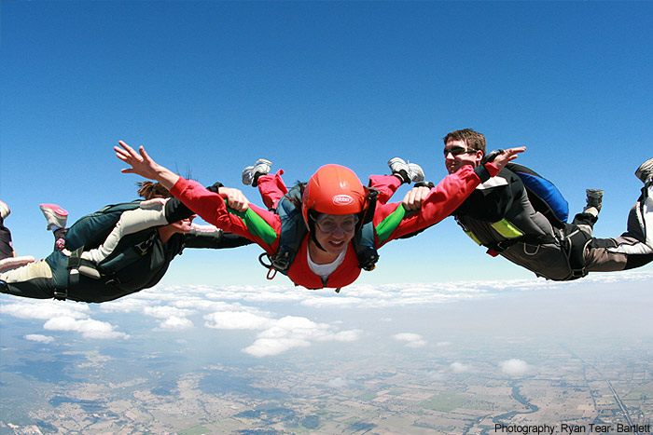
FREE FALL

Slide 18
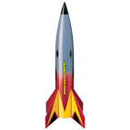
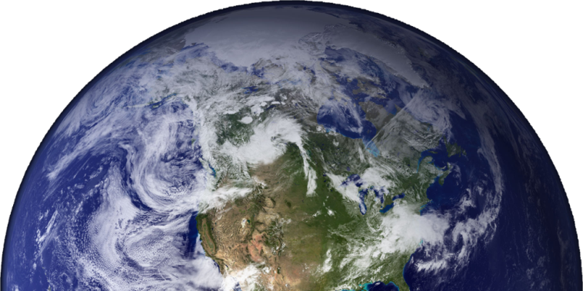
Free Fall
Force acting on ball
Force acting on ball
1. Gravitational force
1. Gravitational force
2. Air resistance
When the body falls towards the earth, under the influence of earth's gravity alone, its motion is called free fall .

Slide 19
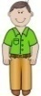
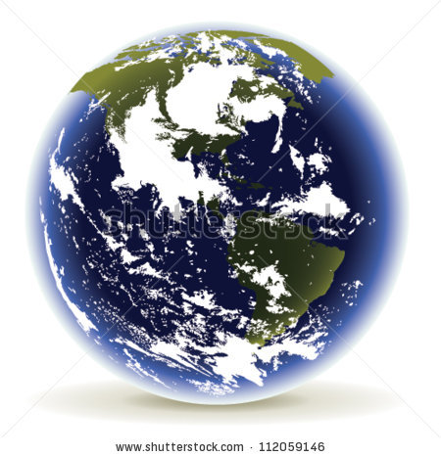
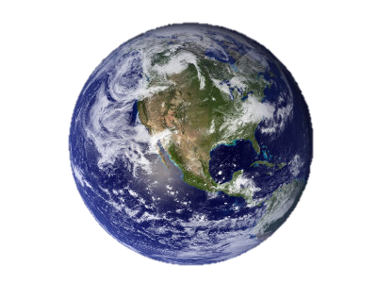
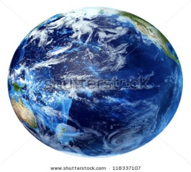
Variation of ( g )
g’= variation in acceleration due to gravity
g=gravity on the surface of earth
d- depth to which person goes
R- radius of earth.
With altitude
With depth
Due to shape of the earth
The value of g decreases as altitude increases.
The value of g decreases as we move towards the center of the earth.
The value of g increases at poles and decreases at equator.
Gravity is inversely proportional to the distance R
Thus (R)decreases (g) increases and vice versa
Earth is not perfectly spherical.
d = R
g’ = g (1- )
Poles are closer to the center than equator.
Let m₁ be the mass of man
Hence if R increases g will decrease
R
As Altitude of a person from center of earth increases
As person goes closer to the center of earth
g = GM
R²
g’ = g (1 – 1)
g’ = 0 ms⁻²
g = GM
R²
R
( )
g’=g 1-d
R
R
R
R

Slide 20
Free fall is governed by three equations of motion
1.
v = u + at
Changes to
v = u + gt
2.
s =
ut + 1 at²
2
Changes to
s =
ut + 1 gt²
2
3.
v² = u² + 2as
Changes to
v² = u² + 2gs
Where ‘u’ and ‘v’ are the initial and final velocities and ‘s’ is the distance covered in time ‘t’.

Slide 21
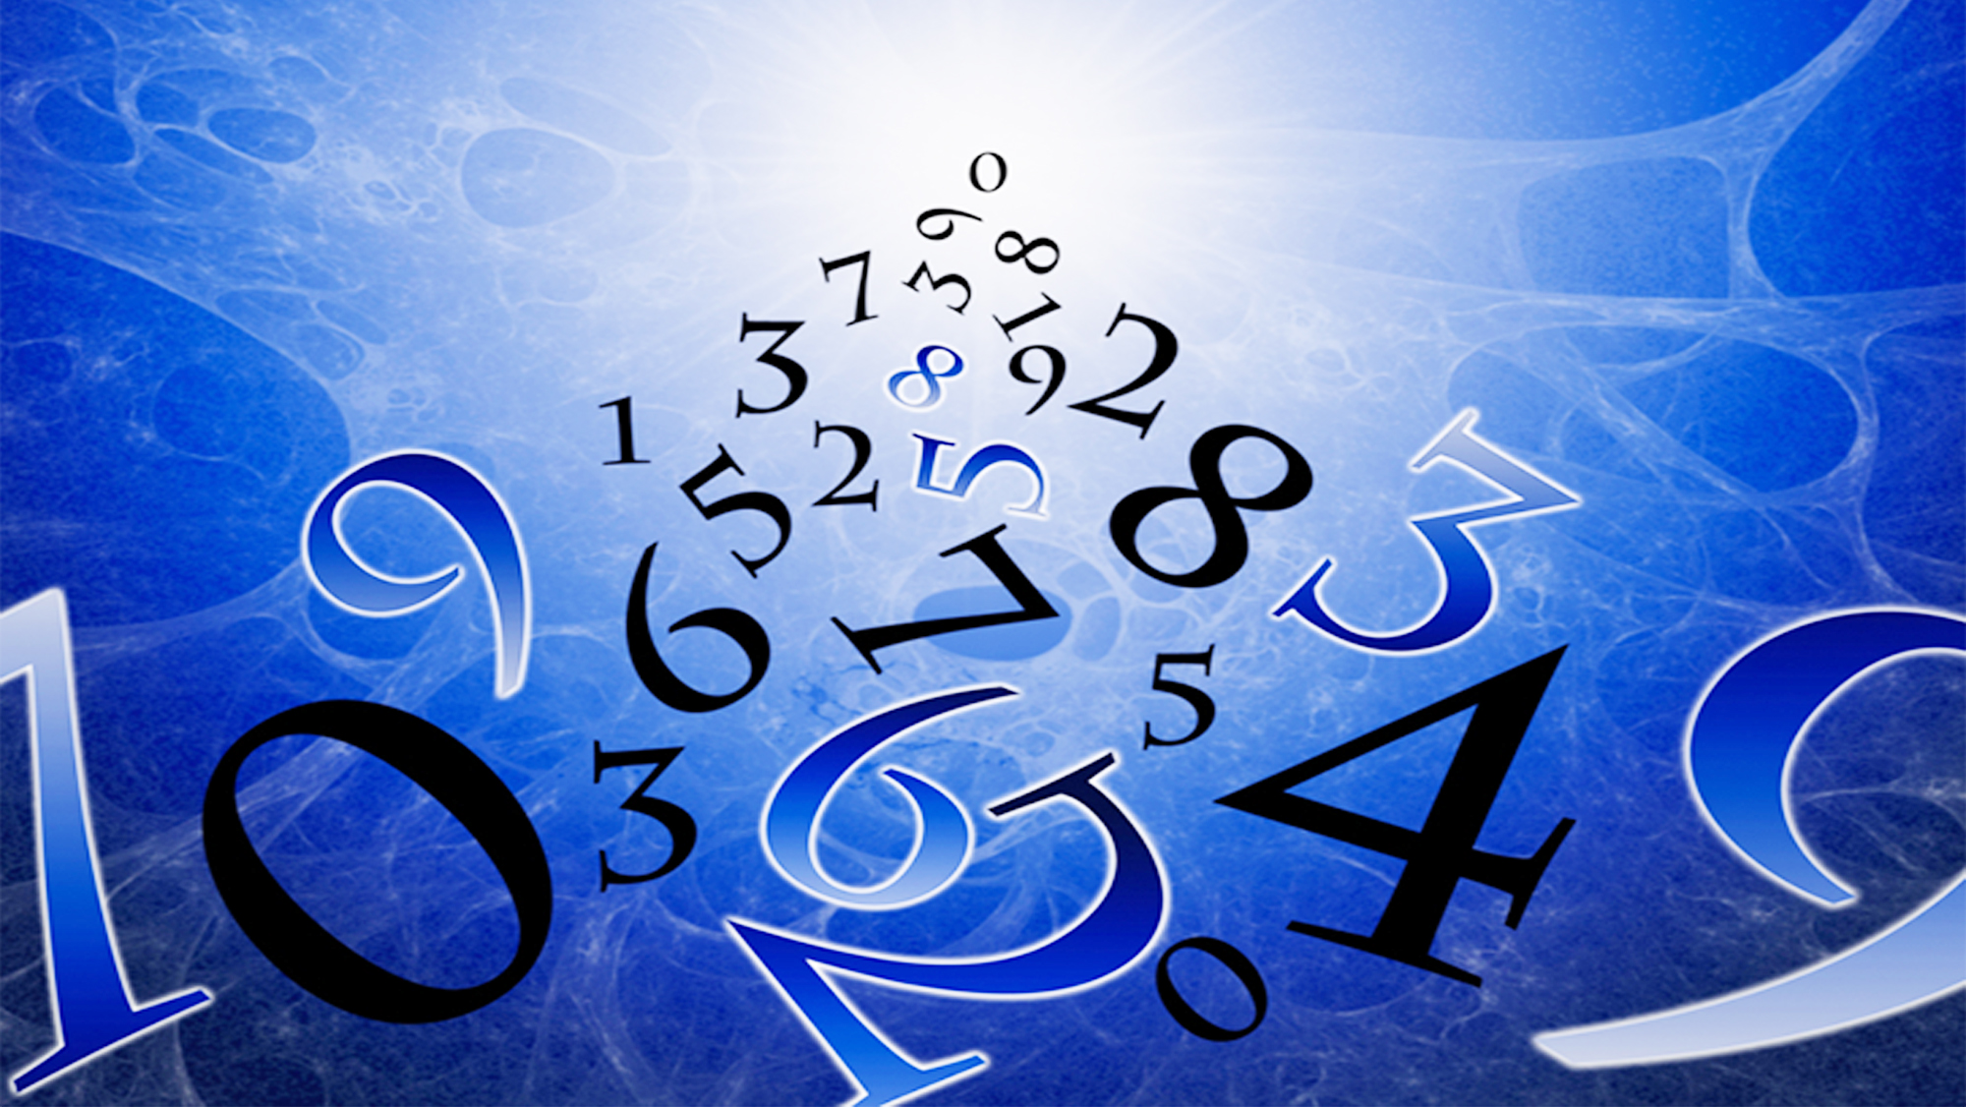

Type - A
Gm₁m₂
numerical
F =
r²
F = mg

Slide 22

Gravitation
Numerical based on Force of gravitation

Slide 23
1
What happens to the force between two objects, if (i) the mass of one object is doubled? (ii) the distance between the objects is doubled and tripled? (iii) the masses of both objects are doubled?
Gm₁m₂
(ii) distance doubled
(iii) distance is tripled
(iii) Mass of both objects is doubled
Formula :
F =
1
r²
F ∝
1
r²
F' ∝
(i) F ∝ m₁ m₂
F ∝ m₁ m₂
Solution :
r²
Now, r' = 2r
Now, r' = 3r
If mass (i) doubled
m'₁
= 2m₁
m'₂
= 2m₂
1
∴
F' ∝
1
F' ∝
m'₁
m'₂
∴
m'
= 2m₁
(r')²
∴
F' ∝
(r')²
1
F' ∝ (2m₁) (2m₂)
∴
F'
∝ m' m₂
F' ∝
1
(2r)²
F' ∝
F' ∝ 4 m₁ m₂
(3r)²
F'
∝ (2m₁) (m₂)
1
F' ∝
F' ∝ 4 F
1
F'
∝ 2(m₁ m₂)
4r²
F' ∝
Ans :
Force becomes four times.
1
9r²
^{th}
∴ Force doubled
Force becomes
1
^{th}
4
Force becomes
9

Slide 24
Gravitation
Numerical based on Force of gravitation

Slide 25
Gravitational force acts on all objects in proportion to their masses. Why then, a heavy object does not fall faster than a light object?
2
Ans :
If F be the gravitational force on a body of mass m, then
GMm
= mg
F =
r²
But also,
GM
g =
r²
Clearly ‘g’ is independent of m, Hence, all bodies fall with
the same rapidness when there is no air resistance.

Slide 26
3
Calculate the force of gravitation between the earth and the
Sun, given that the mass of the earth = 6 × 10²⁴ kg and of the
Sun = 2 × 10³⁰ kg. The average distance between the two is
1.5 × 10¹¹ m.
Given :
Mass of Earth (M_{E})
=
6 × 10²⁴ kg
6.7 × 2 × 6 × 10⁻¹¹ × 10³⁰ × 10²⁴
F
=
Mass of Sun (M_{S})
=
2 × 10³⁰ kg
1.5 × 1.5 × 10²²
distance (R)
=
1.5 × 10¹¹ m
6.7 × 2 × 6 × 10¹¹ ⁺ ³⁰ ⁺ ²⁴ ⁻ ²²
10²¹
Gravitational constant (G)
=
6.7 × 10⁻¹¹ Nm² kg⁻²
=
1.5 × 1.5
To find :
Force of attraction (F) = ?
G Mm
80.4 × 10²¹
Formula :
F
=
=
R²
2.25
G M_{S} M_{E}
Solution :
F
=
= 35.7 × 10²¹
R²
6.7 × 10⁻¹¹
× 2 × 10³⁰
× 6 × 10²⁴
= 3.57 × 10²² N
F
=
(1.5 × 10¹¹)²
Ans :
The force of gravitation between the earth and the sun is 3.57 × 10²² N

Slide 27
Gravitation
Numerical based on Force of gravitation

Slide 28
What is the magnitude of the gravitational force between the earth and a 1 kg object on its surface? (Mass of the earth is 6 × 10²⁴ kg and radius of the earth is 6.4 × 10⁶ m)
4
Given :
Mass of the body (m)
= 1 kg
Mass of the earth (M)
= 6 × 10²⁴ kg
Radius of the earth (R)
= 6.4 × 10⁶ m
To find :
Force (F) = ?
GMm
F =
Formula :
R²
GMm
Solution :
F =
6.67
×
6
×
10
R²
=
6.4 × 6.4
10⁻¹¹ × 10⁺²⁴ × 10⁻¹²
= 10⁻²³⁺²⁴
= 10
6.67 × 10⁻¹¹
×
6 × 10²⁴
× 1
∴
F =
=
9.77N
≅
9.8 N.
(6.4 × 10⁶ )²
Ans :
The magnitude of gravitational force between the earth and 1 kg object on it’s surface is 9.8 N
6.67 × 6 × 10⁻¹¹ ⁺ ²⁴ ⁻ ¹²
=
6.4 × 6.4

Slide 29
5
Why is the weight of an object on the moon 1/6th its weight on the earth?
G M_{E}m
For earth,
Given :
Mass of the Earth (M_{E})
=
5.98 × 10²⁴ kg
W_{E}
=
… … … (2)
R_{E}²
Mass of the Moon (M_{M})
=
7.36 × 10²² kg
Dividing 1 and 2
Radius of the Earth (R_{E})
=
6.4 × 10⁶ m
G M_{M}m
Radius of the Moon (R_{M})
=
1.74 × 10⁶ m
W_{M}
R_{M}²
M_{M}
R_{E}²
1
=
=
×
W_{E}
G M_{E}m
R_{M}²
M_{E}
To find :
Prove that W_{M} =
W_{E}
6
G Mm
R_{E}²
Formula :
W = F
=
W_{M}
7.36 × 10²²
× (6.4 × 10⁶)²
R²
∴
=
G Mm
W_{E}
5.98 × 10²⁴
× (1.74 × 10⁶)²
Solution :
W
=
R²
7.36 × 10²²
× 40.96 × 10¹²
=
G M_{M}m
5.98 × 10²⁴
× 3.0276 × 10¹²
For moon,
W_{M}
=
… … … (1)
R_{M}²
Ans :
1
Weight of an object on the moon is 1/6 of its weight on the Earth.
= 0.165 ≈
6

Slide 30
Gravitation
Numerical based on Mass And Weight

Slide 31
Gravitational force on the surface of the moon is only 1/6 as strong as gravitational force on the earth. What is the weight in newton's of a 10 kg object on the moon and on the earth ?
6
Given :
Mass of the object on the moon
= 10 kg
Mass of the object on the earth
= 10 kg
1
(ii)
W_{M} =
W_{E}
6
To find :
(i) Weight of the object on the earth (W_{E})
= ?
(ii) Weight of the object on the moon (W_{M})
= ?
Formula:
(i) W_{E} = mg
Solution :
Weight of the object on the earth (W_{E})
= mg
= 10
× 9.8
= 98 N
1
1
Weight of the object on the moon (W_{M})
=
W_{E}
=
× 98
= 16.33 N
6
6
Ans :
The weight of the object of mass 10 kg on the moon is 16.33N

Slide 32
Gravitation
Numerical based on kinematical equations

Slide 33
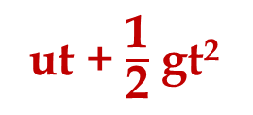
Type - B
v = u + gt
numerical
ut + $\frac{\text{1}}{\text{2}}$ gt²
s =
v² = u² + 2gs

Slide 34
A stone is allowed to fall from the top of a tower 100 m high and at the same time another stone is projected vertically up wards from the ground with a velocity of 25 m/s. Calculate when and where the two stones will meet?
1
Given :
Displacement (s)
= 100 m
u = 0ms⁻¹
To find :
Time and distance when the stones meet = ?
1
Formula :
s =
ut +
gt²
2
x
Solution :
Suppose the two stones meet at a height x from the top of a tower after time t from the start.
100 m
For the downward motion of stone A
100 - x
u = 0ms⁻¹,
g = + 10 ms⁻²,
s = (x)
1
s =
ut +
gt²
2
1
u = 25 ms⁻¹
∴
(x) =
0 +
× 10
× t²
2
1
∴
(x) =
10t²
……. (i)
2

Slide 35
A stone is allowed to fall from the top of a tower 100 m high and at the same time another stone is projected vertically up wards from the ground with a velocity of 25 m/s. Calculate when and where the two stone will meet?
1
u = 0ms⁻¹
Solution :
For upward motion of stone B
u = + 25ms⁻¹,
s = (100 - x),
g = - 10 ms^{–2}
1
s =
ut +
gt²
x
2
As the object goes upwards
1
... (ii)
∴
(100 - x) =
25 t –
× 10
× t²
100 m
2
1
1
100 - x
∴
100 -
10t²
=
25t -
10t²
∴
x =
5
× 4 × 4
2
2
∴
100
=
25t
∴
x =
80 m
∴
t
=
4 s
u = 25 ms⁻¹
From equation (i),
1
Ans :
The two stones meet after 4s at a height of 80 m from the top of the tower and are 20 m from surface of the earth.
× (4)²
(x) =
10
2

Slide 36
Gravitation
Numerical based on kinematical equations

Slide 37
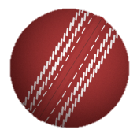
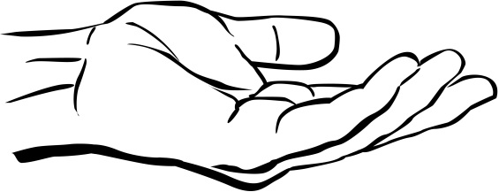
2
A ball thrown up vertically returns to the thrower after 6 s. Find the velocity with which it was thrown up.
6
Time of ascent
= Time of descent
= 3 s
Given :
=
2
To find :
Initial velocity (u) = ?
Formula :
v =
u + gt
Solution :
(a) For upward motion of the ball,
v = 0ms⁻¹,
t = 3 s,
g = -9.8 ms⁻²
v =
u + gt
t = 6 sec
∴
0 =
u
+
(- 9.8 × 3)
∴
u
0 =
–
9.8 × 3
∴
u =
9.8 × 3
∴
u =
29.4 ms⁻¹
Ans :
The ball was thrown with the velocity of 29.4ms⁻¹

Slide 38
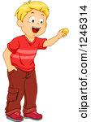
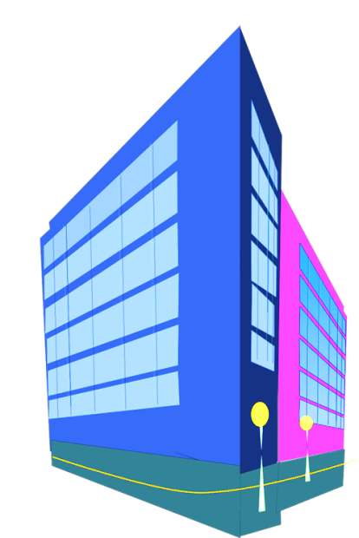

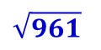
3
A boy drops a coin from the top of a building which is 49 m high. Find the velocity with which the coin strikes the ground.
Given :
Initial velocity (u)
= 0
Displacement (s)
= 49m.
Acceleration due to gravity (g)
= 9.8 m/s²
Initial velocity is 0
To find :
Final velocity (v) = ?
Formula :
v² =
u² + 2gs
49 m
Solution :
v² =
u²
+
2gs
v² =
(0)²
+
2
×
9.8
×
49
But we take the answer
as – 31 as it is
directed downwards
v² =
$\sqrt{961}$ Can be ± 31
961
v =
$$\sqrt{961}$$
The velocity with which the coin strikes the
ground is 31 m/s.
Ans :
v =
Displacement of coin is 49 m
– 31 m/s (– ve sign as it is directed downwards)

Slide 39
Gravitation
Numerical based on kinematical equations

Slide 40

A ball is thrown vertically upwards with a velocity of 49 m/s.
Calculate (i) the maximum height to which it rises, (s) (ii) the total time (t) it takes to return to the surface of the earth.
(g = -9.8ms⁻²)
4
1
5
u
= 49 m s⁻¹
49 × 49
Given :
∴
s
=
49 × 49 × 10
∴
s
=
2 × 9.8
v = 0 m/s
g
= -9.8ms⁻²
2 × 98
2
1
v
= 0 m s⁻¹
49 × 5
∴
s
=
= 122.5 m
(i) The maximum height to which it rises (s)
= ?
2
To find :
(ii)
v
= u + gt
(ii) The total time it takes to return to the surface of the earth (t)
= ?
0
= 49
– 9.8 × t
49
∴
t
=
Formula :
v²
= u² + 2 gs
9.8
u = 49 m/s
∴
t
= 5 s
Solution :
v²
= u² + 2 gs
∴
Time of ascent
= Time of descent
(0)²
= (49)²
+ 2 × (- 9.8) s
∴
0
= 49 × 49
– 2
× - 9.8 s
Time taken by the stone to return to the earth’s surface
Ans :
The ball rises to height of 122.5m and
it takes 10 seconds to return to the surface
∴
= 2t
= 2 × 5
= 10 s
∴
(49 × 49)
= 2
× 9.8 s

Slide 41
Gravitation
Numerical based on kinematical equations

Slide 42
5
A stone is released from the top of a tower of height 19.6m.
Calculate its final velocity just before touching the ground.
Given :
Initial velocity (u)
= 0ms⁻¹
Displacement (s)
= 19.6m
To find :
Final velocity (v) = ?
Formula :
v² – u²
= 2 gs
Solution :
v² – u²
= 2 gs
∴
v² – (0)²
= 2
× 9.8
× 19.6
∴
v²
= 19.6
× 19.6
∴
v
= 19.6 m s^{–1}
Ans :
The final velocity just before touching the ground is 19.6 m s⁻¹

Slide 43
A stone is thrown vertically upward with an Initial velocity of 40 m/s. Taking g = 10m/ s², find the maximum height reached by the stone. What is the net displacement and the total distance covered by the stone?
6
Given :
u
= 40 m s⁻¹
-(40 × 40)
s
=
= 80 m
g
= -10 ms⁻²
-20
v
= 0 m s⁻¹
(ii) Total distance covered
= s + s = 80 + 80 = 160 m
(i) The maximum height reached by the stone (s)
= ?
To find :
(ii) The total distance covered by the stone
= ?
(iii) Net displacement
= 80 - 80 = 0 m
(iii) The net displacement = ?
Formula :
v²
= u² + 2 gs
Solution :
v²
= u² + 2 gs
(0)²
= (40)²
= 2 × (- 10) s

